Slide 1

Cassandra NoSQl Database
By Sahil Ajmera, Sanyukta Sanjay Kate, Karshit Shah, Ankita Nadig

Slide 2
Limitations of RDBMS
Scalability issues
Expensive Joins
Database locks - user requests queued

Slide 3
High level Features
Distributed and Decentralized
Elastically Scalable
Column-Oriented
High Availability and Fault Tolerance
Tunable Consistency
Schema Free
High Performance

Slide 4
Birth of Cassandra
Developed at Facebook to power their inbox search feature - relational database management systems no longer valid for data in huge volume and high velocity
Open source project on Google Code in 2008
Apache Incubator project in 2008
Made top-level project in 2010

Slide 5
Data Storage
Cassandra stores data in a different way than RDBMS
Can handle unstructured data and can store it in a structured format
Cannot handle operations such as joins, group by, aggregation, the way RBMS does
Data stored in a cluster which is made out of nodes structured in ring
Replica of every node in the cluster is created which is used when the actual node fails
Replica of nodes is created using a namespace called “keyspace”

Slide 6
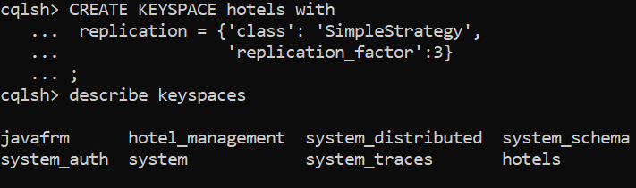
Example of creating a keyspace
Figure 1: Syntax for creating a keyspace called hotels for the hotel management application using Cassandra

Slide 7
Data Storage
Keyspace has three properties:
Replication Factor: denotes the number of replicas to create
Strategy: Simple Strategy, Old Network Topological Strategy, Network Topological Strategy
Column Families: collection of rows, where each row has a any number of columns (row key x column key x column value)
Rows in RDBMs have the same number of columns in a relation; ones which do not have, are marked with NULL value

Slide 8
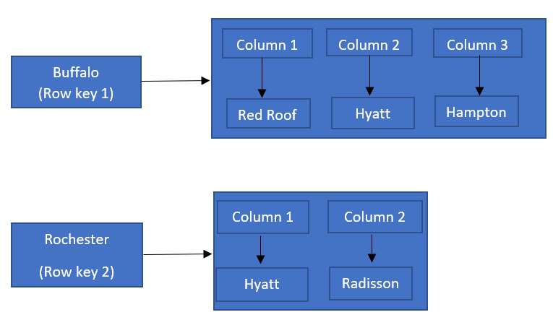
Example of a column family
Figure 2: Column Family of HotelByCity for Hotel Management where rows are cities and columns are hotels

Slide 9
Indexes
Cassandra uses indexes based off on non-primary keys known as “secondary indexes”
The secondary indexes are present in a hidden column family
Indexes are stored in unsorted form
Cassandra is good for equality search and not for range searches
For range searches, multiple nodes have to interact to acquire the results, merge them and return it back

Slide 10
Query Processing and Optimization
The query language that is used by Cassandra is known as CQL (Cassandra Query Language).
To run CQL queries, `cqlsh` tool is used in Cassandra.
The query is sent to Cassandra over a network connection when it is submitted through ‘cqlsh’ tool.

Slide 11
Query Processing and Optimization
A daemon is waiting for the queries which generates a response for each of the received queries.
After the response is generated, it is sent to the originator. Netty, which is a client server framework enables quick and easy development of network applications is used by Cassandra to handle the network connections.
Then CQL query is processed by calling different classes and methods.

Slide 12
Transaction Management
Cassandra does not support ACID transactions, rollback and flocking mechanisms, instead follows the CAP theorem which provides wither AP or CP depending on the application requirements.
Row or partition level atomicity is supported
Read, write and delete operations is isolated.
The durability of data is increased with the replication of data on different nodes

Slide 13
Consistency - Tunable Consistency
you can vary the consistency level of the operation so the data returned is more or less consistent
Many levels of consistency is supported
Read, write and deletion is done based on these consistency levels

Slide 14
Consistency - Linearizable Consistency
It is an immediate isolation for lightweight transactions
The Paxos protocol(using quorum based algorithm) can be used to implement the serial operations

Slide 15
Security
TLS/SSL encryption for communication
Client authentication
Authorization

Slide 16
Database Application
Display the different cities to choose a hotel from
Show the available hotels in a region
View the available rooms for the selected hotel
Make the booking
Check if the booking is successful

Slide 17
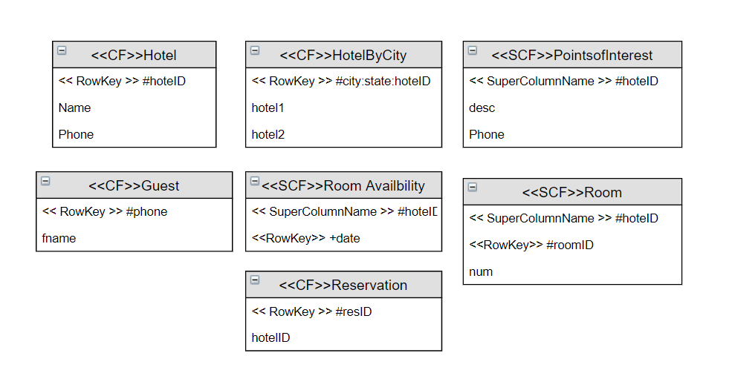
Cassandra Model for Application(Draft)

Slide 18
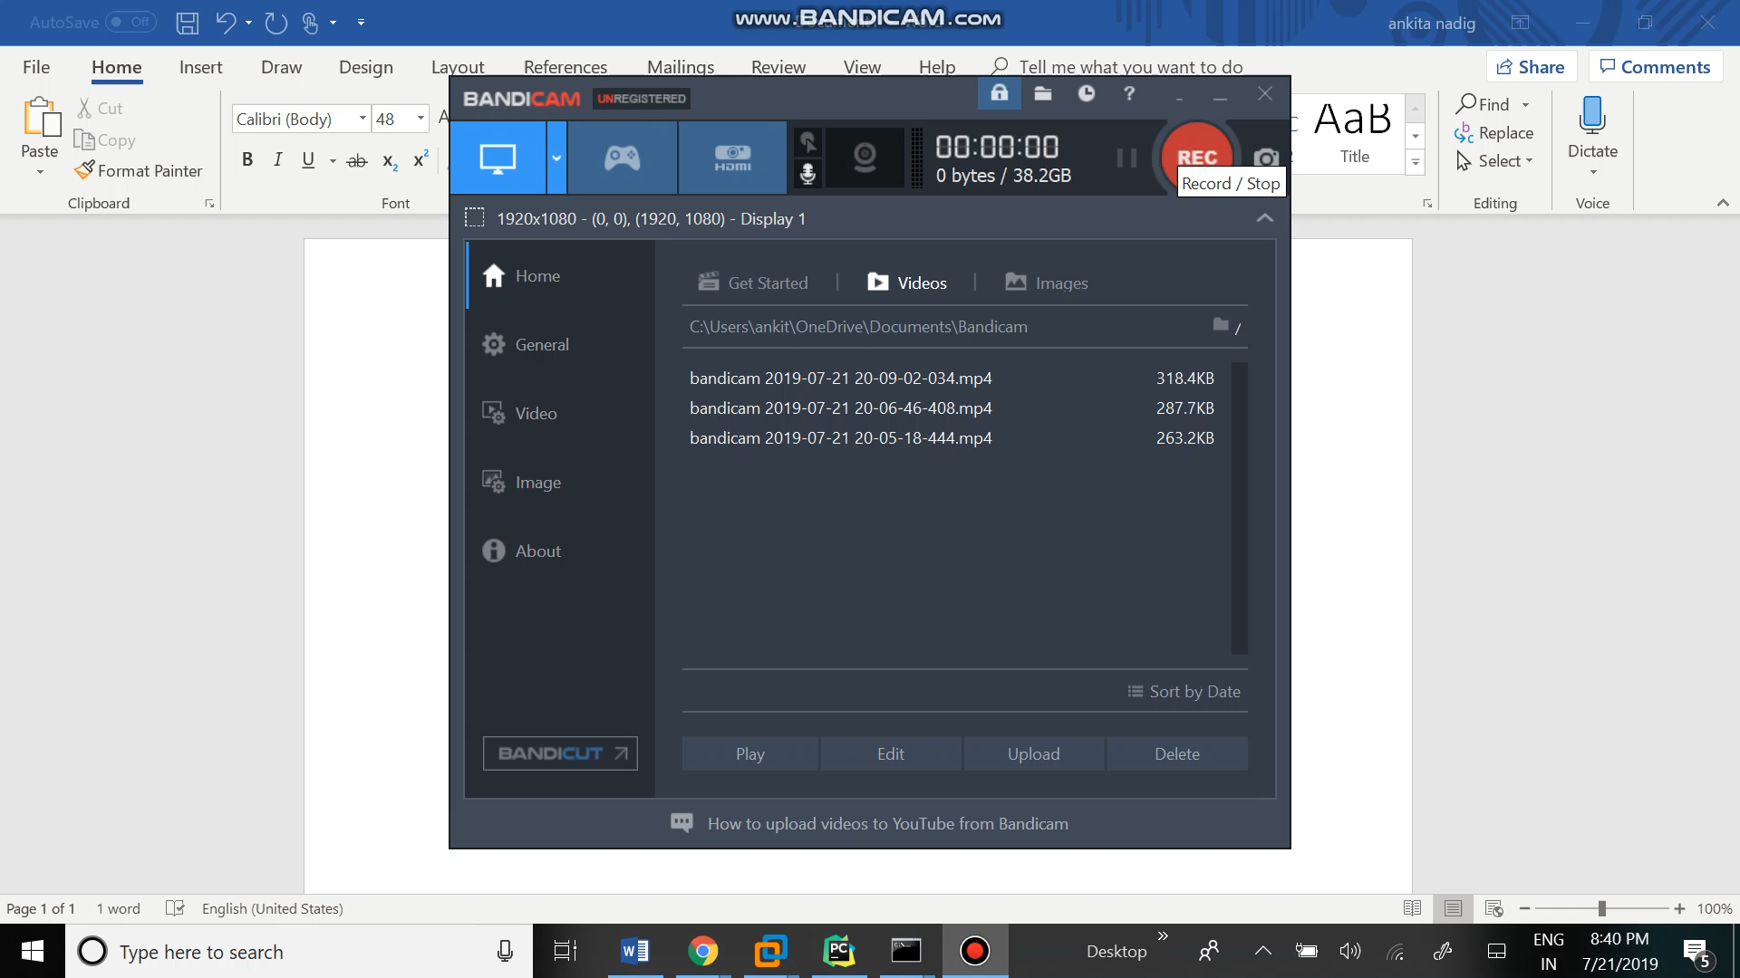
Video for making the systems are distributed:

Slide 19
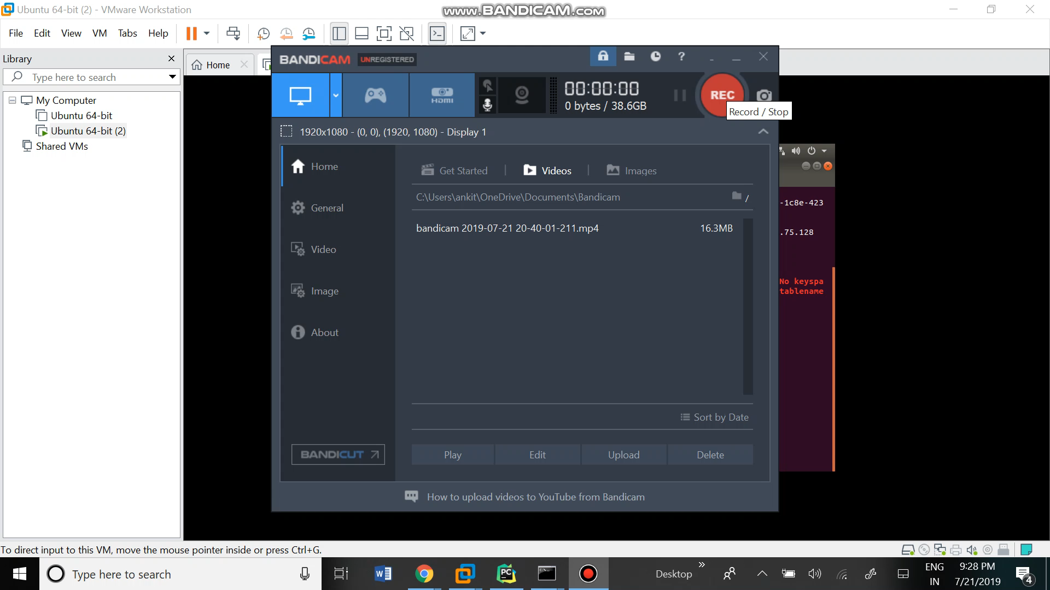
Video describing the application:

Slide 20
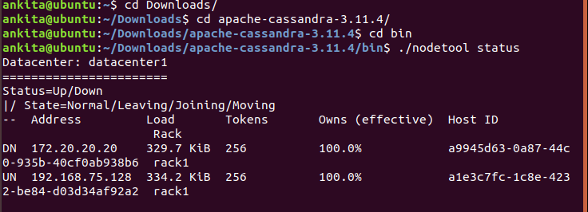
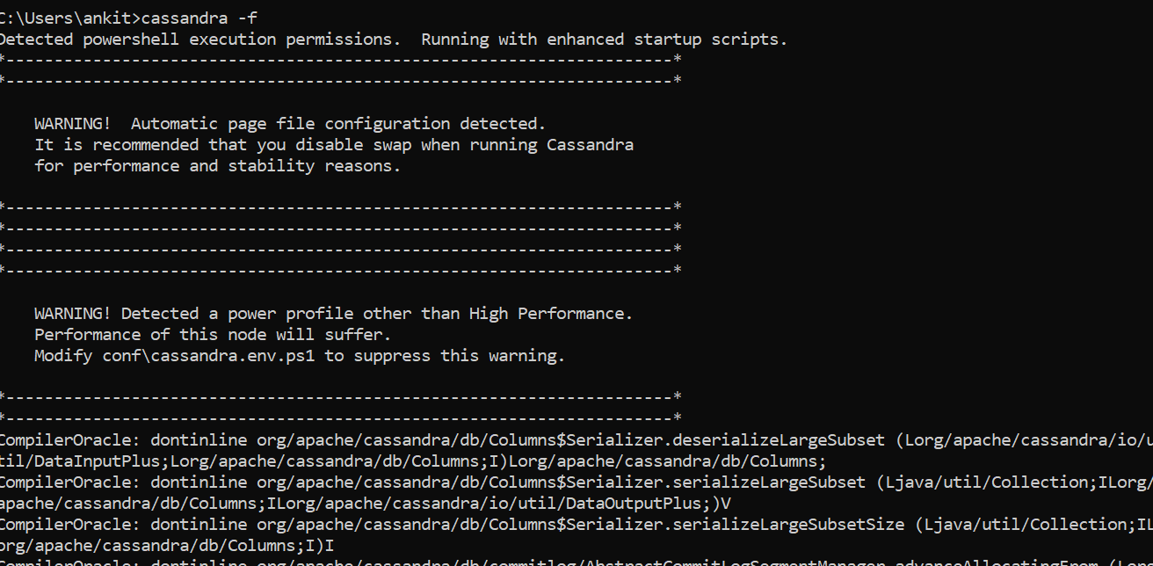
Screenshots of the distributed system
Node tool status command shows the 2 IP addresses connected. Therefore, is distributed
Cassandra –f is used to start the server

Slide 21
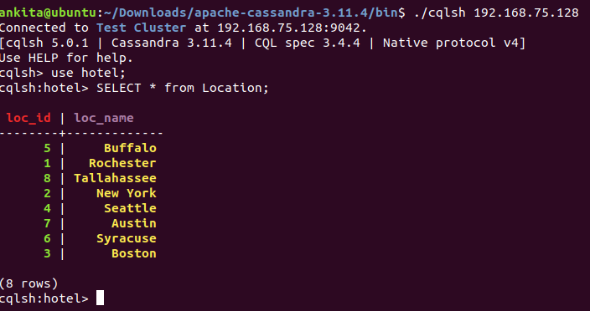
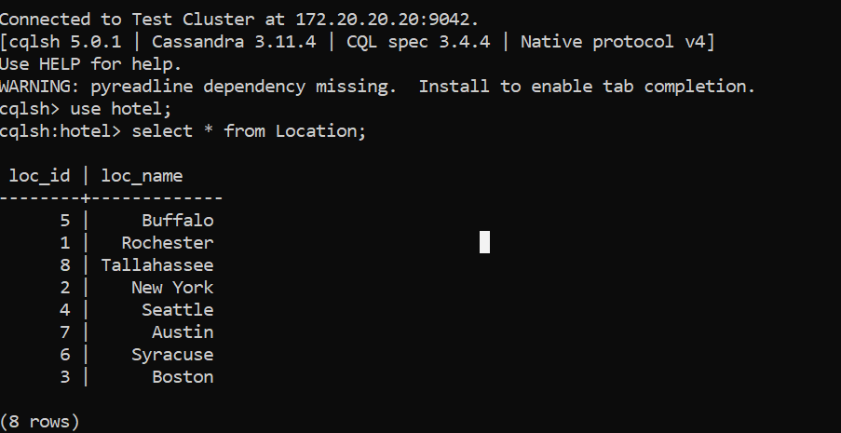
Screenshots to show the distributed property
The columnfamily ‘Location’ is available on both the systems simultaneously.
Any changes made to one DB, will be reflected in the other.

Slide 22
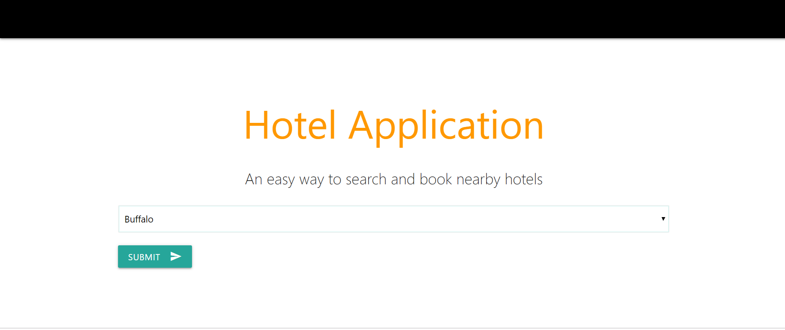
Screen shots of the app: display the cities

Slide 23
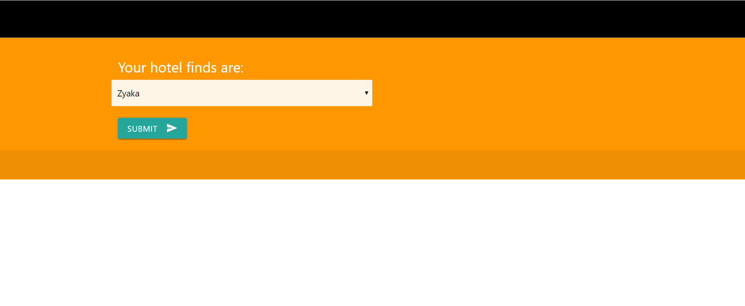
Hotels in each city

Slide 24
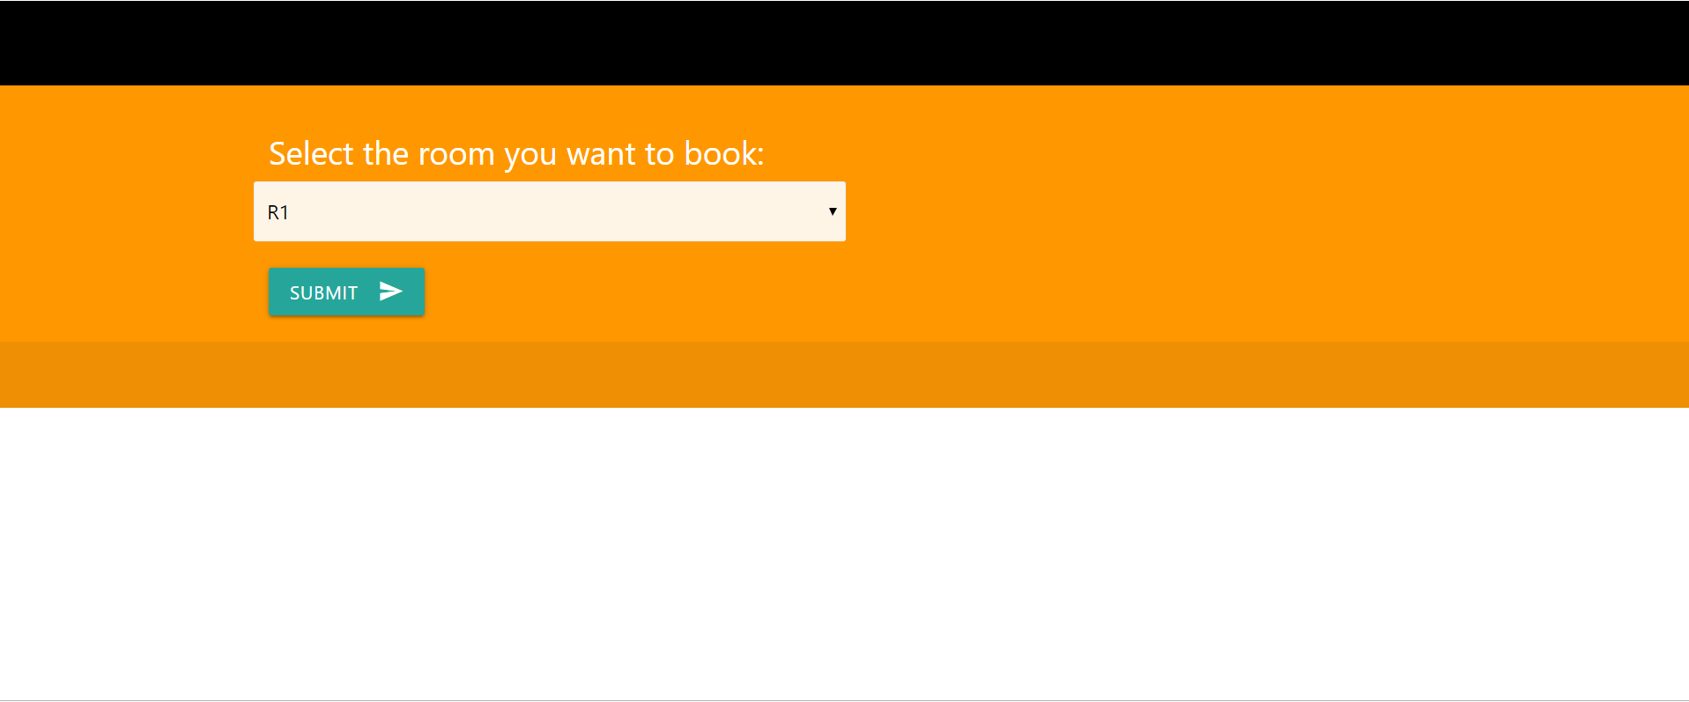
Available rooms in each hotel

Slide 25

Room booked

Slide 26
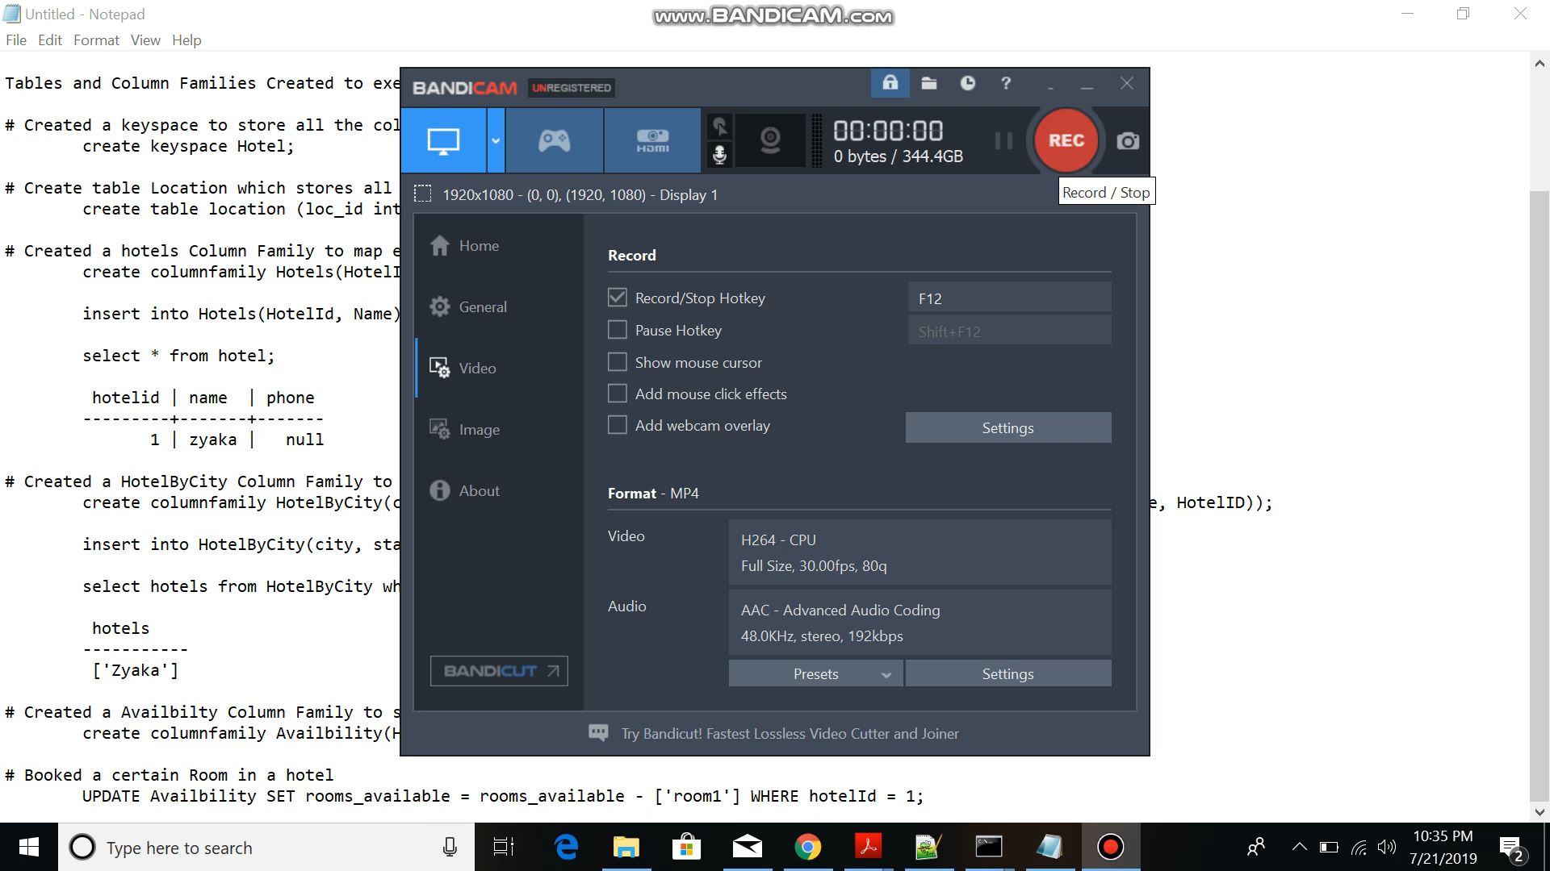
Schema

Slide 27
Final Remarks
Cassandra is a distributed system and decentralized
Can store unstructured data in a structured form, unlike RDBMS
Stored data in nodes and uses keyspace to define every node
Cannot perform operations such as joins, aggregation, etc unlike RDBMS
Good for Equality searches as the indexes are unsorted

Slide 28
Final Remarks(Cont.)
Cassandra has its known query language known as Cassandra Query Language.
More efficient in reading and writing data as compared to RDBMS.
Cassandra does not satisfy the acid property, instead only follows AID.
Partition and availability(AP) is given preference over consistency.
It follows the CAP theorem.
The consistency is configurable using the levels in consistency.

Slide 29
References
1][n.d.].CAP theorem. https://wiki.apache.org/cassandra/ArchitectureOverview . Accessed: July 04, 2019.
[2][n.d.]. Cassandra data model datastax. https://www.datastax.com/dev/blog/basic-rules-of-cassandra-data-modeling . Accessed: July 04,2019.
[3][n.d.]. Cassandra Guide. https://learning.oreilly.com/library/view/cassandra-the-definitive/9781491933657/ch05.html . Accessed: July 04,2019.
[4][n.d.]. Cassandra Indexing - teddyma. https://teddyma.gitbooks.io/learncassandra/content/model/indexing.html

Slide 30
References(Cont.)
[5][n.d.]. Cassandra Keyspace strategies. https://www.vskills.in/certification/tutorial/big-data/apache-cassandra/replica-and-their-placement/ . Accessed: July 04, 2019.
[6][n.d.]. consistency levels. http://cassandra.apache.org/doc/latest/architecture/dynamo.html . Accessed: July 04, 2019.
[7][n.d.]. Data Consistency. https://docs.datastax.com/en/archived/cassandra/3.0/cassandra/dml/dmlAboutDataConsistency.html . Accessed: July 04, 2019.
[8][n.d.]. eventual consistency. https://en.wikipedia.org/wiki/Eventual_consistency . Accessed: July 04, 2019.

Slide 31
References(Cont.)
[9][n.d.]. Lightweight Transactions in Cassandra. https://www.datastax.com/dev/blog/lightweight-transactions-in-cassandra-2-0 . Accessed:July 04, 2019.
[10][n.d.]. Query Optimzation. https://www.scnsoft.com/blog/cassandra-performance . Accessed: July 04, 2019.
[11][n.d.]. Query Processing. https://www.mahdix.com/blog/2016/06/01/how-apache-cassandra-executes-cql-queries/ . Accessed: July 04,2019.
[12][n.d.]. Security. http://cassandra.apache.org/doc/latest/operating/security.html . Accessed: July 04, 2019.

Slide 32
References(Cont.)
[13][n.d.]. Transaction properties. https://docs.datastax.com/en/archived/cassandra/2.0/cassandra/dml/dml_about_transactions_c.html . Ac-cessed: July 04, 2019.
[14]2019. Cassandra Data Model - javatpoint. https://www.javatpoint.com/cassandra-data-model . Accessed: July 04, 2019.
[15]2019. Cassandra Features - javatpoint. https://www.javatpoint.com/cassandra-features . Accessed: July 04, 2019.
[16]2019. Cassandra Keyspace Javatpoint - javatpoint. https://www.javatpoint.com/cassandra-create-keyspace . Accessed: July 04, 2019.[17] Eben Hewitt. 2010.Cassandra: The Definitive Guide. O’Reilly Media.

Slide 33
Thank you

